Slide 1
J2EE/JEE
(Java 2 Enterprise Edition)
Technology

Slide 2
Objective
At the end of the course, you will have acquired basic knowledge and sufficient experience to:
  What is Java EE.
  An overview of Java EE features, technologies and services. (JSP, Servlet, EJB, JSF, JDBC, JNDI, Java Mail, JMS, etc…)
  An overview of Java EE frameworks and new technologies, approaches.
  An overview of Java EE design patterns.
  Ability to build J2EE/JEE enterprise application.

Slide 3
Content #1
Part I: Web Tier
Chapter 1. Introduction to J2EE/JEE
Chapter 2. Servlet Programming
Chapter 3. Java Server Page
Chapter 4. JSP, Servlet & JavaBean in MVC Model
Chapter 5. JSP taglib & Custom tags

Slide 4
Content #2
Part 2: Business Tier
Chapter 6. Introduction to EJB
Chapter 7. Session bean
Chapter 8. Message-Driven Bean
Chapter 9. Java Persistence

Slide 5
Content #3
Part 3: XML & Webservices
Chapter 10: XML
Chapter 11: Webservices

Slide 6
Content #4
  Part 4: Frameworks (struts framework)
  Chapter 12. Introduction to Struts framework
  Chapter 13. Actions & ActionServlet
  Chapter 14. Validation
  Chapter 15. Struts Tag Lib
  Chapter 14: Struts application examples

Slide 7
References
Main references
[1] Prentice Hall Ptr Java(Tm) Ee 5 Tutorial, The (3Rd Edition) (The Java Series)
[2] Java EE 5 Technologies & Specifications
Other references
[3] http://java.sun.com
[4] www.theserverside.com
[5] http://groups.google.com.vn/group/uit_j2ee/
The j2ee subject’s resources (Content, Slides, Exercises, Books, Ref, …)

Slide 8
Exams
Exams are required
  The exercises: 40%
  The writing test: 60% (multi-choice)
  Seminar: bonus scores

Slide 9
Chapter 1
An Introduction to
J2EE/JEE technology

Slide 10
What Is Java EE?
Java Platform, Enterprise Edition or Java EE
  Java EE vs. Java SE (Java Standard Edition)
  Java EE vs. Java ME (Java Micro Edition)
Java EE is a Sun specification implemented by independent vendors:
  IBM WebSphere, BEA Weblogic
  Jboss, GlassFish
The Java EE platform uses a distributed multitiered application model for enterprise applications.
An enterprise application is any application that applies to an entire enterprise. (http://wiki.answers.com/Q/What_is_enterprise_application)

Slide 11
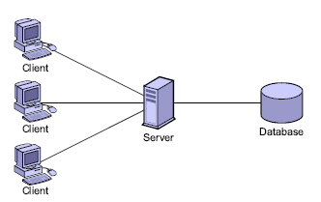
Minimum Distributed Systems

Slide 12
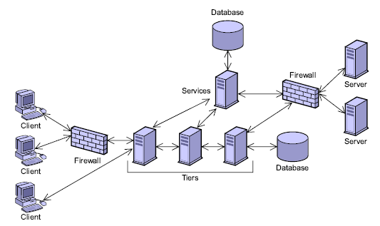
Highly Distributed Systems

Slide 13
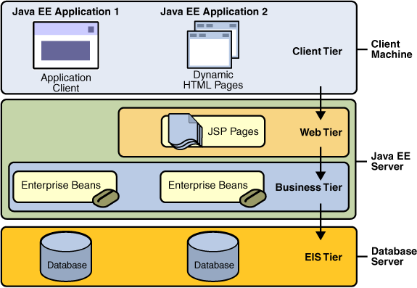
JEE Distributed Multitiered Application

Slide 14
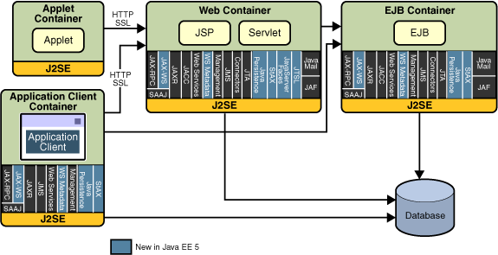
Java EE Architecture

Slide 15
Java EE Server and Containers
Java EE server: The runtime portion of a Java EE product. A Java EE server provides EJB and web containers.
Enterprise JavaBeans (EJB) container: Manages the execution of enterprise beans for Java EE applications.
Web container: Manages the execution of JSP, Servlet, and Java Server Faces.
Application client container: Manages the execution of application client components.
Applet container: Manages the execution of applets. Consists of a web browser and Java Plug-in running on the client together.

Slide 16
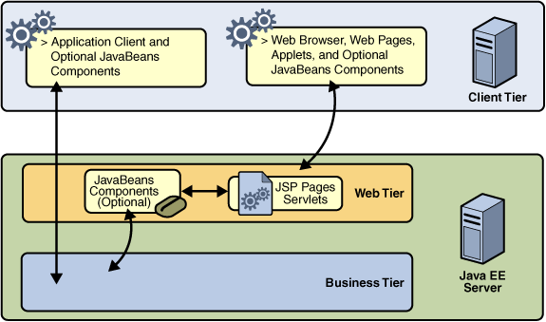
Web-Tier overview

Slide 17
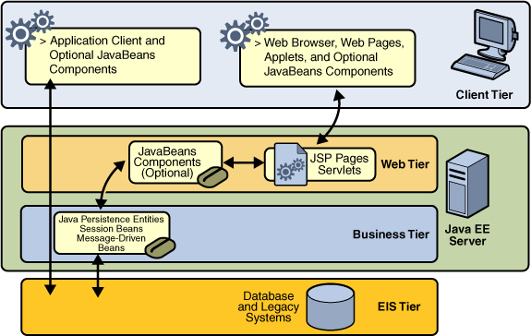
Business-Tier overview

Slide 18
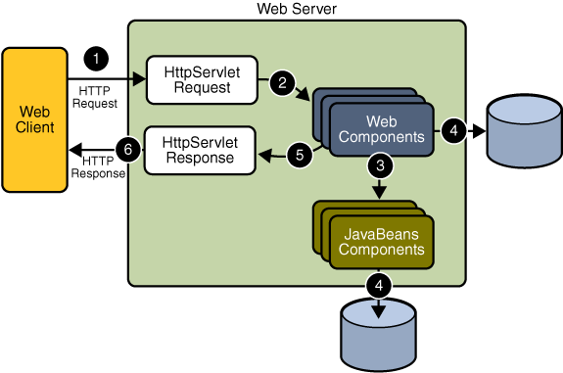
Java Web Application Request Handling

Slide 19
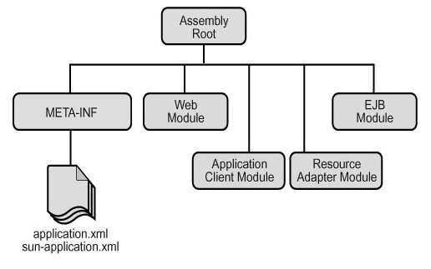
Packaging applications

Slide 20
Packaging applications
A Java EE module
  One or more Java EE components for the same container type
  One component deployment descriptor of that type
Java EE modules
  EJB modules, which contain class files for enterprise beans and an EJB deployment descriptor. EJB modules are packaged as JAR files with a .jar extension.
  Web modules, which contain servlet class files, JSP files, supporting class files, GIF and HTML files, and a web application deployment descriptor. Web modules are packaged as JAR files with a .war (Web ARchive) extension.
  Application client modules, which contain class files and an application client deployment descriptor. Application client modules are packaged as JAR files with a .jar extension.

Slide 21
Development roles
Java EE Product Provider: product providers are typically application server vendors who implement the Java EE platform according to the Java EE 5 Platform specification.
Tool Provider: the tool provider is the company or person who creates development, assembly, and packaging tools used by component providers, assemblers, and deployers.
Enterprise Bean Developer
  Writes and compiles the source code
  Specifies the deployment descriptor
  Packages the .class files and deployment descriptor into the EJB JAR file

Slide 22
Development roles
Web Component Developer
  Writes and compiles servlet source code
  Writes JSP, JavaServer Faces, and HTML files
  Specifies the deployment descriptor
  Packages the .class, .jsp, and .html files and deployment descriptor into the WAR file
Application Client Developer

Slide 23
Development roles
Application Assembler
  Assembles EJB JAR and WAR files created in the previous phases into a Java EE application (EAR) file
  Specifies the deployment descriptor for the Java EE application
  Verifies that the contents of the EAR file are well formed and comply with the Java EE specification
Application Deployer and Administrator
  Deploys/installs the Java EE application EAR file into the Java EE server

Slide 24
Server, tools – Apache Tomcat
Messaging
JavaMail
JMS
Services
JDBC, JINI,
XML, JTA,..
Communication
SSL,
RMI-IIOP,..
No App. Services
EJB container
Session Entity
Bean Bean
No Business Logic
Web container
JSP HTML/XML
Serlvet
Presentation Logic
http://tomcat.apache.org/

Slide 25
Server, tools – Jboss 4.0 or later
Messaging
JavaMail
JMS
Services
JDBC, JINI,
XML, JTA,..
Communication
SSL,
RMI-IIOP,..
No App. Services
EJB container
Session Entity
Bean Bean
Business Logic
Web container
JSP HTML/XML
Serlvet
Presentation Logic
http://jboss.org/

Slide 26
Server, tools – BEA-Weblogic
Messaging
JavaMail
JMS
Services
JDBC, JINI,
XML, JTA,..
Communication
SSL,
RMI-IIOP,..
App. Services
EJB container
Session Entity
Bean Bean
Business Logic
Web container
JSP HTML/XML
Serlvet
Presentation Logic
Oracle Completes Acquisition of BEA Systems (Apr 2008)
http://www.bea.com/weblogic/

Slide 27
J2EE/JEE Server
The JBoss open source application server.
http://www.jboss.org
BEA Systems' WebLogic application server.
http://www.weblogic.com
IBM's WebSphere application server.
http://www-4.ibm.com/software/webservers/appserv
The Orion application server web site.
http://orion.evermind.net
The iPlanet application server web site.
http://www.iplanet.com
Oracle's application server
http://www.oracle.com/ip/deploy/ias
Silverstream's eXtend application server.
http://www.silverstream.com/Website/app/en_US/AppServer
Borland's application server
http://www.borland.com/bes/appserver
Macromedia's JRun application server.
http://www.macromedia.com/software/jrun/
….

Slide 28
Sun Java System Application Server
http://java.sun.com/javaee/downloads/index.jsp
Starting and Stopping the Application Server
asadmin start-domain --verbose domain1
asadmin stop-domain domain1
A domain is a set of one or more Application Server instances managed by one administration server. Associated with a domain are the following:
  The Application Server's port number. The default is 8080.
  The administration server's port number. The default is 4848.
  An administration user name and password.
The --verbose flag causes all logging and debugging output to appear on the terminal window or command prompt (it will also go into the server log, which is located in <JAVAEE_HOME>/domains/domain1/logs/server.log).

Slide 29
Sun Java System Application Server
Starting the Admin Console
  http://localhost:4848/asadmin/
  Programs → Sun Microsystems → Application Server PE → Admin Console

Slide 30
Running jee examples
Reference to:
Prentice Hall Ptr Java(Tm) Ee 5 Tutorial, The (3Rd Edition) (The Java Series)
  Chapter no.2 (Getting start with web applications)
  About This Tutorial → About the Examples
The link to download JEE Tutorial & Examples
http://java.sun.com/javaee/5/docs/tutorial/doc/
http://java.sun.com/javaee/5/docs/tutorial/information/download.html

Slide 31
Web modules
In the Java EE architecture, web components and static web content files such as images are called web resources. A web module is the smallest deployable and usable unit of web resources. A Java EE web module corresponds to a web application as defined in the Java Servlet specification.

Slide 32
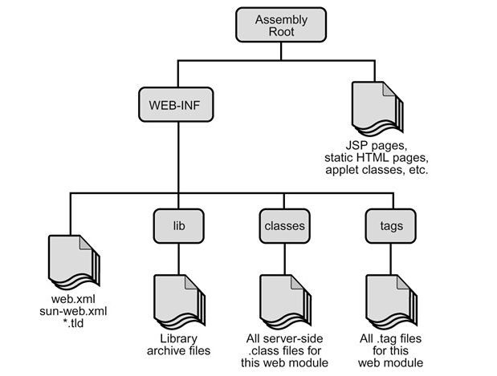
Web modules
The structure of a web module that can be deployed on the Application Server is shown:

Slide 33
Packaging web modules
You package a web module into a WAR by using the ant utility, or by using the IDE tool of your choice
To build the hello1 application with NetBeans 5.5, follow these instructions
1. | In NetBeans 5.5, select FileOpen Project.
2. | In the Open Project dialog, navigate to: <INSTALL>/javaeetutorial5/examples/web/
3. | Select the hello1 folder.
4. | Select the Open as Main Project checkbox.
5. | Click Open Project Folder.
6. | In the Projects tab, right-click the hello1 project and select Build Project.

Slide 34
Packaging web modules
To build the hello1 application using the ant utility, follow these steps
1. | In a terminal window, go to <INSTALL>/javaeetutorial5/examples/web/hello1/.
2. | Run ant. This target will spawn any necessary compilations, copy files to the <INSTALL>/javaeetutorial5/examples/web/hello1/build/ directory, create the WAR file, and copy it to the <INSTALL>/javaeetutorial5/examples/web/hello1/dist/ directory

Slide 35
Deploying a WAR file
You can deploy a WAR file to the Application Server in a few ways:
Copying the WAR into the <JavaEE_HOME>/domains/domain1/autodeploy/ directory.
Using the Admin Console.
By running asadmin or ant to deploy the WAR.
To deploy or undeploy a WAR with asadmin, open a terminal window or command prompt and execute:
asadmin deploy full-path-to-war-file
asadmin undeploy context_root

Slide 36
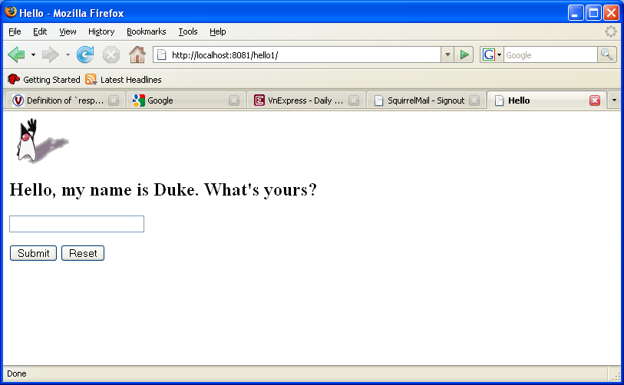
Testing Deployed Web Modules
http://localhost:8080/hello1

